Slide 1
TOP DOWN APPROACH
Presented by Hưng

Slide 2


Table of content
1 What We will find out what is a top-down approach.
2 How How can we use it properly?
3 Why Why is it important?
4 How I apply it in my project

Slide 3
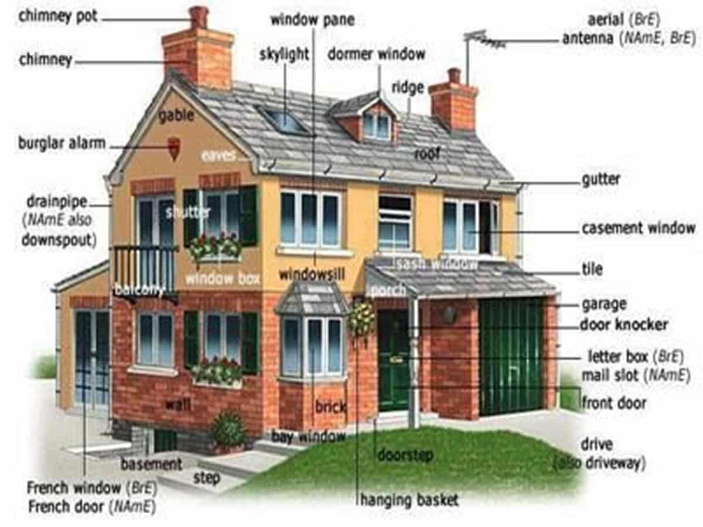
1. What is top-down approach
Imagine you are going to build a big house, what are you going to do first? You don’t know where to start, or what to do?

Slide 4
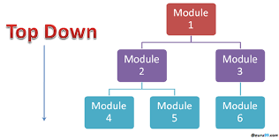
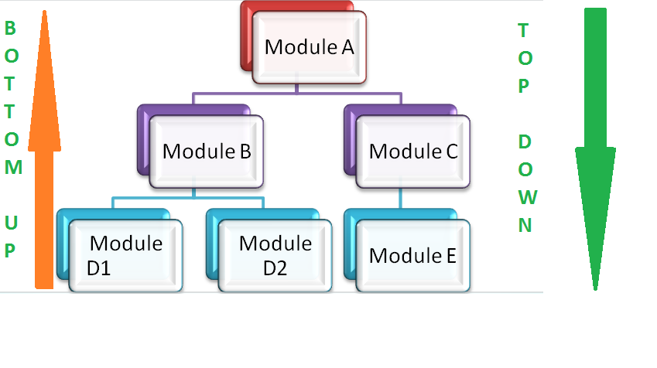
So your solution is top-down approach

Slide 5
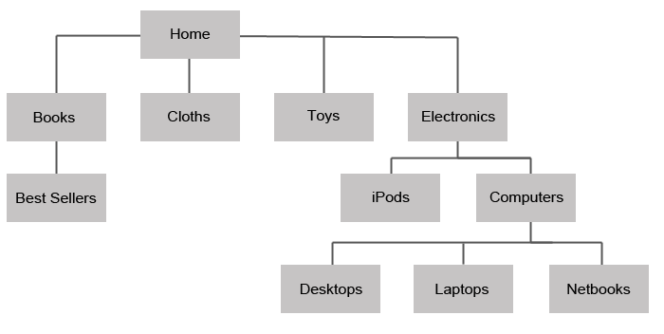
It is a strategy method by which we will: 1) Begin with a broad view of the problems 2) Follow a systematic process from top to bottom. 3) Break the big problem into smaller and more manageable parts. 4) Often used in many fields such as software development, project management, and problem-solving. 5) Often structured in a hierarchical structure
SO WHAT IS TOP-DOWN APPROACH EXACTLY

Slide 6
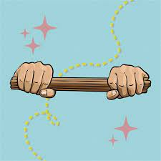
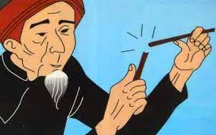
SO WHAT IS TOP-DOWN APPROACH EXACTLY
UNABLE TO BREAK
BREAK EACH ONE EASILY

Slide 7
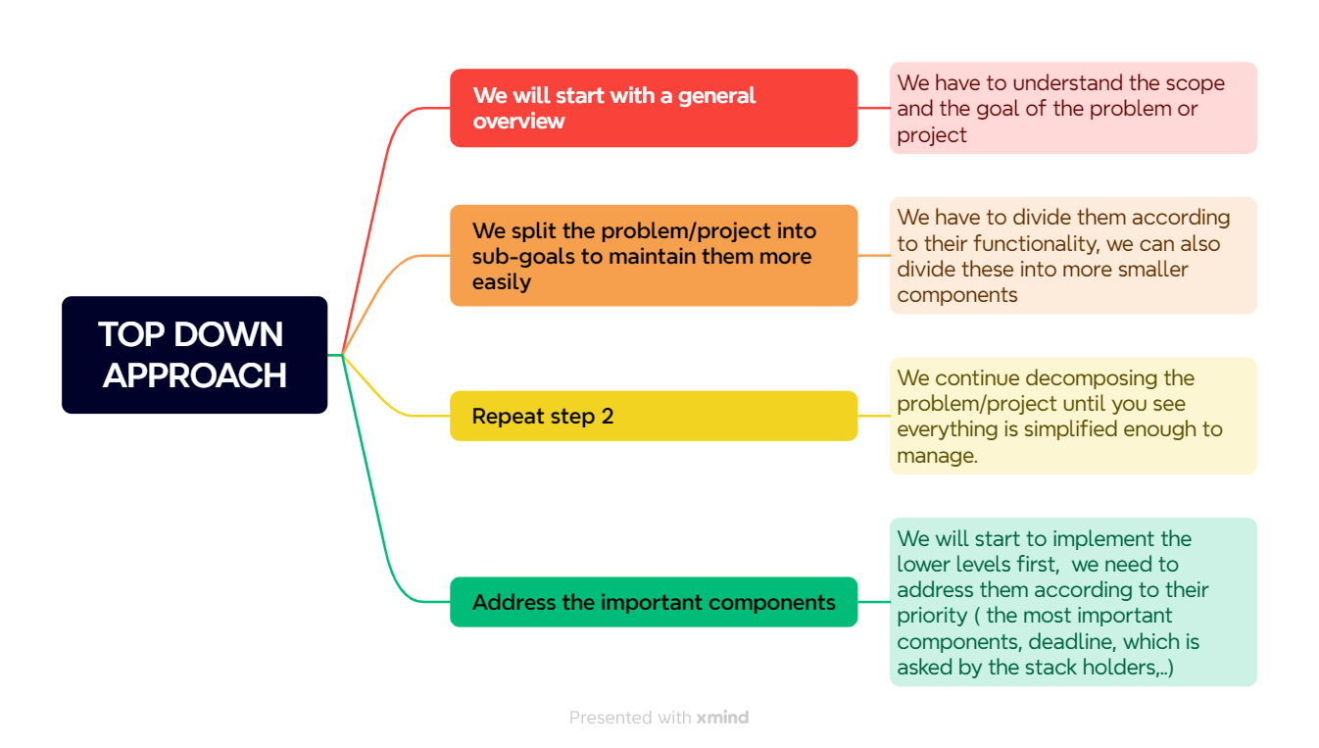
2. How can we use it

Slide 8
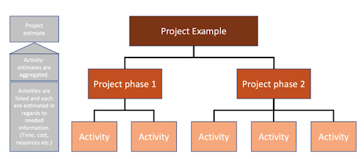
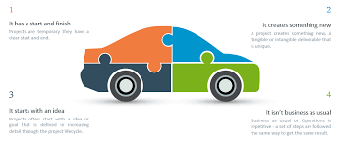
Examples.
Imagine you have a final project, you can apply top-down like this:
1) Split the project into 2 phases (phase one and phase two).
2) In each phrase define the activities or goals you need to achieve.
3) Determine which one is the most important and put it on a to-do list.
4) Integrate these components to build the complete system.

Slide 9

3 WHY IS IT IMPORTANT

Slide 10

ADVANTAGES AND DISADVANTAGES OF TOP-DOWN APPROACH
ADVANTAGES | DISADVANTAGES
We view have a clear view of our goal | Important details are likely to be ignored
Effectively manage the large system | Dependency on initial understanding:
Easier Planning and Coordination | Inflexibility
Easily to identify the key components | Slow to adjust
Quicker implementation | Less creativity
Ideal for a big and complex project | Not ideal for a small project

Slide 11
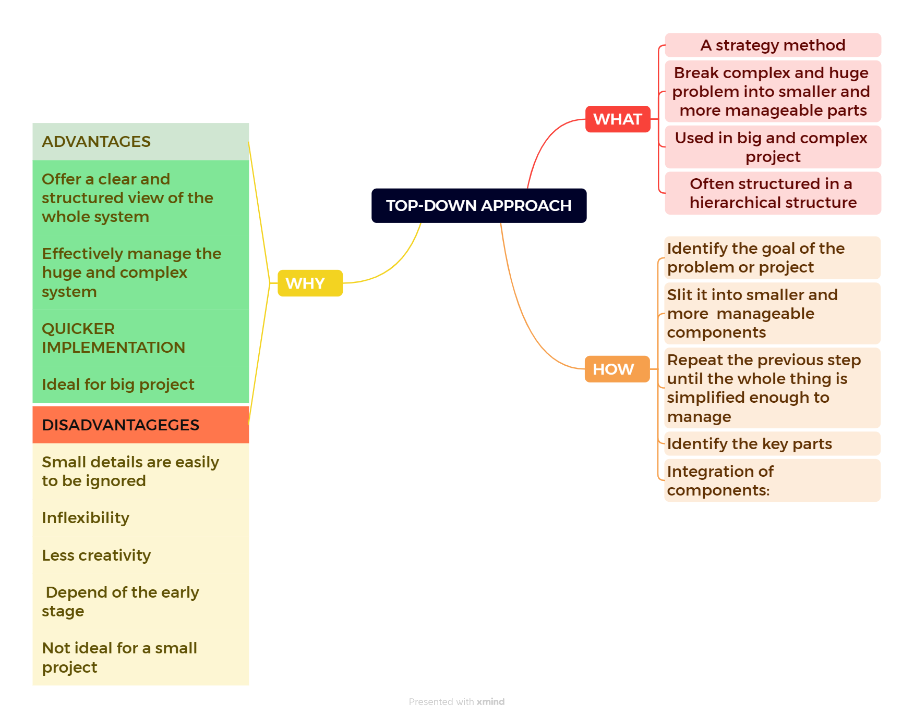
CONCLUSION
CONCLUSION

Slide 12

Many companies use the top-down approach in their management and decision-making processes, including: 1) IBM 2) GOOGLE 3) MICROSOFT 4) APPLE 5) AMAZON
Nguồn: theguardian.com

Slide 13

4. How I use it in real life
MY ENGLISH FORUM WEBSITE

Slide 14
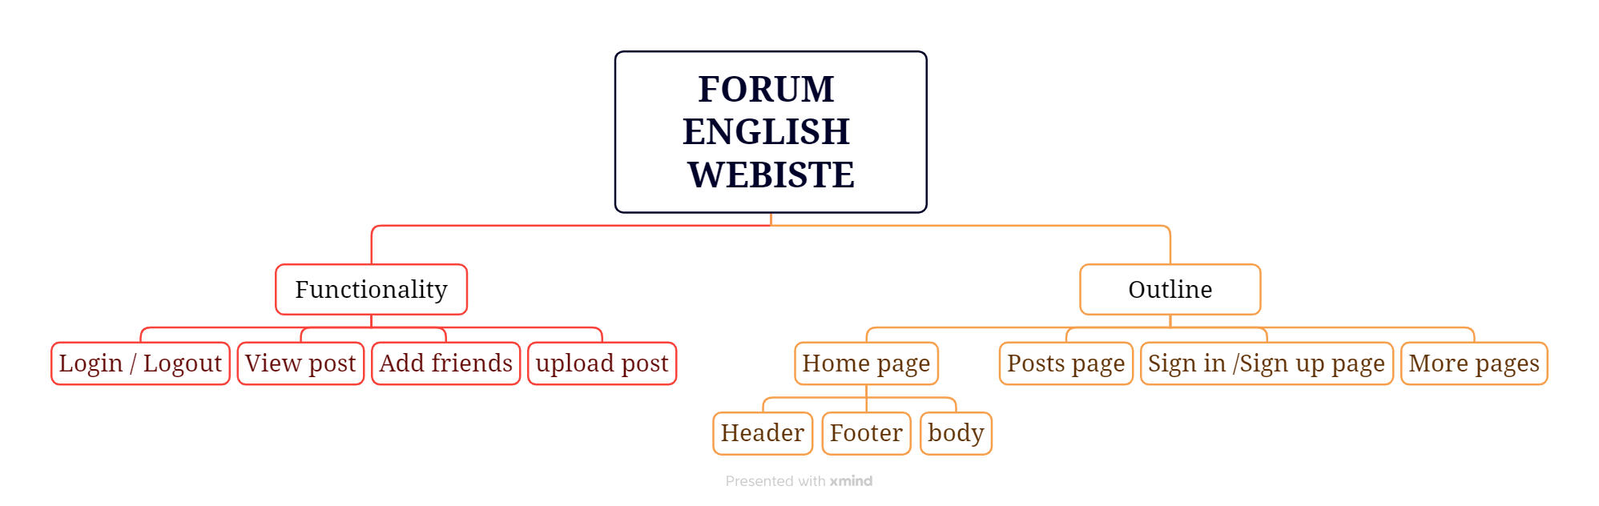

Slide 15
THANK YOU FOR LISTENING

